Slide 1
Automated Detection and Classification of Leaf Diseases in Black Gram Using Deep Learning Techniques
Nurjahan Akther Mim
ID : 221-15-4782
Department of CSE
Daffodil International University
Mr. Mayen Uddin Mojumdar
Sr. Lecturer
Department Of CSE
Daffodil International University

Slide 2
Outline
Introduction
Problem Statement
Motivation and Objective
Related Works
Comparison Between Existing Works
Gap Analysis
Proposed Methodology
Q & A

Slide 3
Introduction
Black gram is an important pulse crop in South Asia, including Bangladesh, valued for its nutritional benefits, soil fertility improvement, and economic importance. However, diseases like Yellow Mosaic Virus (YMV), Cercospora Leaf Spot, Leaf Crinkle, Anthracnose, and Powdery Mildew significantly reduce yield and quality.
Traditional detection methods rely on farmers or experts visually inspecting leaves, which is slow, subjective, and often inaccurate in real farming conditions.
Recent research shows that Deep Learning, especially Convolutional Neural Networks (CNNs), can detect plant diseases from images with high accuracy. However, many existing models are large, require high computing power, and are not suitable for rural areas with limited internet and hardware resources.
This research develops a lightweight CNN model for detecting five types of black gram leaf diseases using a custom, expert-labeled dataset collected from fields in Bangladesh. The dataset was preprocessed using resizing, CLAHE contrast enhancement, and normalization, and balanced through data augmentation.

Slide 4
Problem Statement
High Crop Losses – Black gram yield and quality are heavily affected by diseases such as Yellow Mosaic Virus (YMV), Cercospora Leaf Spot, Leaf Crinkle, Anthracnose, and Powdery Mildew.
Limitations of Manual Inspection – Current detection methods depend on farmers or experts visually checking leaves, which is slow, subjective, and often inaccurate in real farming conditions with varying lighting and complex backgrounds.
Lack of Lightweight AI Solutions – Many deep learning approaches for plant disease detection are computationally heavy, require high-end hardware, and are not suitable for rural farming areas with limited resources.
Limited Multi-Disease Field Performance – Few existing systems can accurately detect and classify multiple black gram diseases from field-captured images with high accuracy.
Dataset Imbalance – The collected dataset showed uneven class distribution, which can bias model learning and reduce generalization.
Deployment Limitations – Many current solutions are not optimized for offline, mobile-based use, preventing instant diagnosis in areas without stable internet.

Slide 5
Motivation and Objective
Motivation | Objective
Black gram is a vital crop in Bangladesh, important for nutrition, soil fertility, and rural livelihoods. Leaf diseases like YMV, Cercospora Leaf Spot, Leaf Crinkle, Anthracnose, and Powdery Mildew cause major yield loss. Traditional visual detection is slow, subjective, and often inaccurate in real farming conditions. Deep Learning (CNNs) can detect diseases from images, but existing models are too large and resource-heavy. A lightweight, offline-capable mobile solution can provide farmers with instant, accurate diagnosis in the field. | Develop a lightweight CNN model to detect and classify five black gram leaf diseases. Preprocess images using resizing, CLAHE contrast enhancement, and normalization. Balance dataset classes through Keras-based augmentation techniques. Evaluate multiple CNN architectures to select the most efficient and accurate model. Deploy the final model via TensorFlow Lite in a Flutter mobile app for offline, real-time use.

Slide 6
Related Works
Hajare & Rajawat (2025) – Proposed a deep ensemble model combining DBN, RNN, and CNN optimized with the SIDMO algorithm for black gram disease classification, improving feature learning but with high computational cost.
Jyothi & Prasad (2025) – Developed a Deep-Transformation Algorithm (DTA) with CLAHE preprocessing and Watershed segmentation for accurate Cuscuta detection in black gram leaves.
Thangaraj et al. (2024) – Compared multiple transfer learning architectures such as NASNet and ResNet50 for black gram leaf disease identification, highlighting architecture complexity and dataset requirements.
Prasanth et al. (2023) – Combined CNN with Local Binary Pattern (LBP) and SVM for enhanced disease classification in black gram leaves.
Pandey et al. (2021) – Applied SVM with spatial features for automated chlorosis detection in Vigna mungo, emphasizing low computational cost for real-time use.

Slide 7
Comparison Between Existing Works
Author & Year | Method / Approach | Accuracy | Contribution
Hajare & Rajawat (2025) | Deep ensemble (DBN, RNN, CNN) + SIDMO | 94.82% | Used different deep learning models together with an optimization method to detect black gram diseases better.
Jyothi & Prasad (2025) | VGGNet + CLAHE + Watershed segmentation | 99.78% | Created a preprocessing method to find and identify Cuscuta disease in black gram leaves more accurately.
Talasila et al. (2025) | DeepLabv3+ (ResNet-18) + EfficientNet-B0 | 99.72% | Combined image segmentation and classification to detect diseases in real farming conditions.
Sangar & Rajasekar (2025) | Wavelet-transformed AttentionNet + SVM | 99.50% | Used wavelet techniques and attention methods to improve how the model understands disease features.
Sharma & Kumar (2024) | Hybrid CNN–Transformer | 99.56% | Combined CNN with Transformer architecture for robust multi-disease classification.

Slide 8
Gap Analysis
Models achieve high accuracy in lab datasets but fail in real-field conditions.
Small and unbalanced datasets limit generalization.
Complex hybrid models not suitable for mobile or low-resource devices.
Lack of early-stage disease and severity level detection.
Segmentation methods struggle with low contrast or overlapping leaves.
Augmentation cannot replicate true environmental diversity.
No large-scale, multi-location field validation.
Minimal integration with real-time farmer feedback or IoT systems.

Slide 9
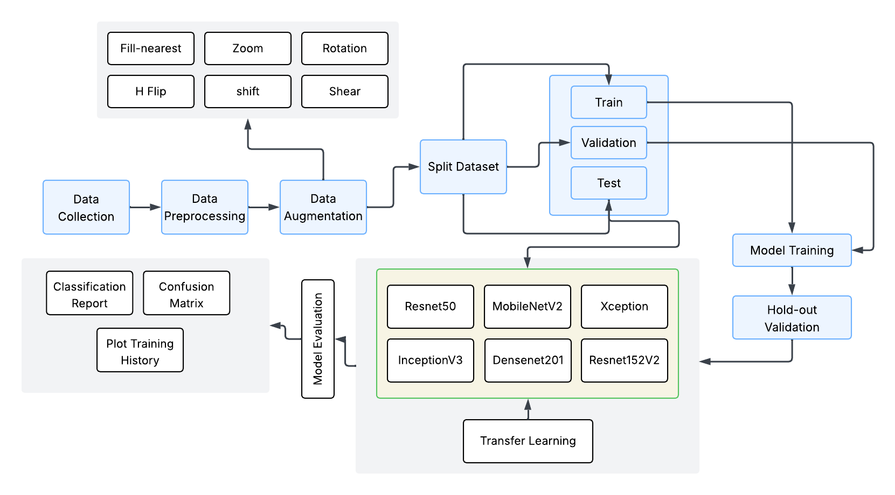
Proposed Methodology

Slide 10
THANK YOU

